Slide 1

Headline Verdana Bold
Audit Online – Release 5.2
High Level Architecture
WBS: LPX24441-01-01-01-U121
CMDB: CI0010195
Notes:
Version Check
Please verify that you are using the latest version of the template and ensure you keep the version number in the top right corner.

Slide 2
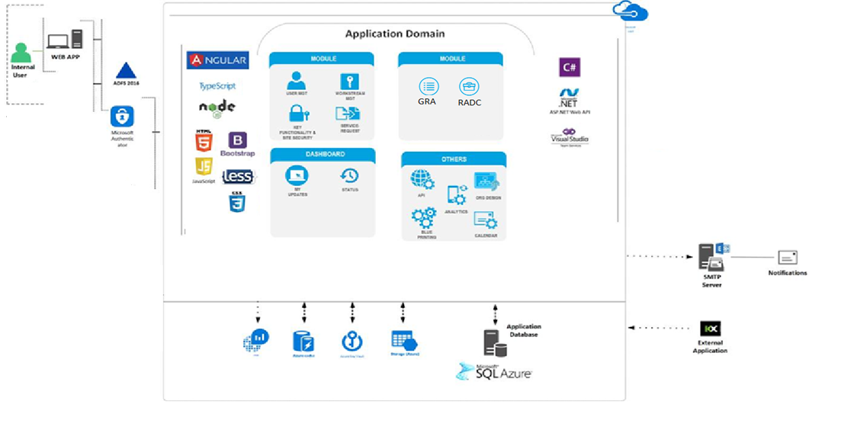
Conceptual System Diagram
Notes:
Define Actors – End users and systems that use the solution
UI Technologies – Technologies used in the presentation layer, such as JavaScript libraries and UI frameworks
Domain Model – Conceptual model of the business domain modeled by the application, including key concepts, roles and datatypes.
Cross Cutting Concerns – Technologies used to support key functionality or NFRs across the solution such as storage, configuration, logging, secret management, databases, etc.
Backend Technologies – Server side technologies that are used to host or implement functionality such as APIs, web applications, ETL, background jobs
External Dependencies – External systems that are not part of the solution, but that the solution depends on. Examples may include SMTP, external APIs, Office 365, external data sources such as MDR
PAR Template Diagrams - https://applicationstandards.deloitte.com/app/core/governance/application

Slide 3
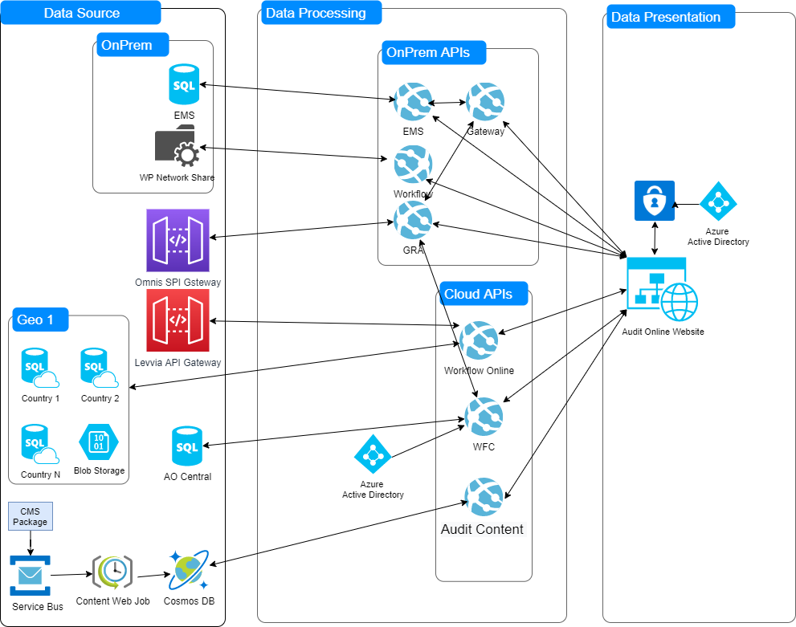
Data Flow
Notes:
Please be sure to use the legend in your diagram.
PAR Template Diagrams - https://applicationstandards.deloitte.com/app/core/governance/application

Slide 4
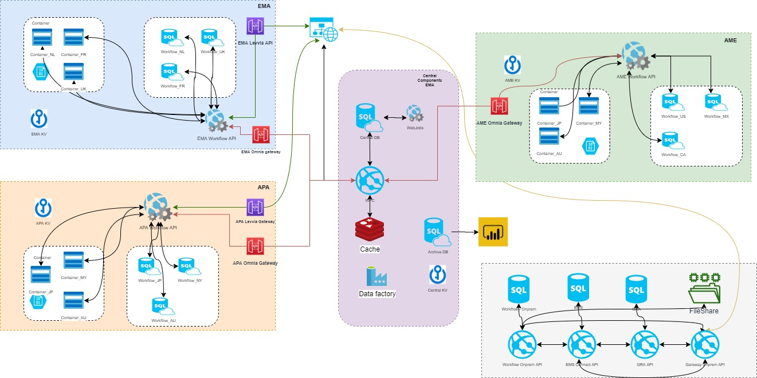
Infrastructure View (Multi-geo)
Notes:
Notes
Include server details for all environments (minimum prod)
Firewall terminating at F5 or Web Server nodes
PAR Template Diagrams
https://applicationstandards.deloitte.com/app/core/governance/application

Slide 5
About Deloitte Deloitte refers to one or more of Deloitte Touche Tohmatsu Limited, a UK private company limited by guarantee (“DTTL”), its network of member firms, and their related entities. DTTL and each of its member firms are legally separate and independent entities. DTTL (also referred to as “Deloitte Global”) does not provide services to clients. Please see www.deloitte.com/about for a detailed description of DTTL and its member firms. Please see www.deloitte.com/us/about for a detailed description of the legal structure of Deloitte LLP and its subsidiaries. Certain services may not be available to attest clients under the rules and regulations of public accounting. Copyright © 2021 Deloitte Development LLC. All rights reserved. Member of Deloitte Touche Tohmatsu Limited

